Slide 1
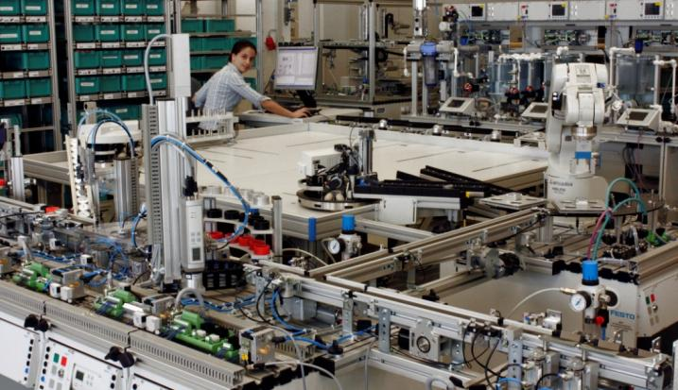
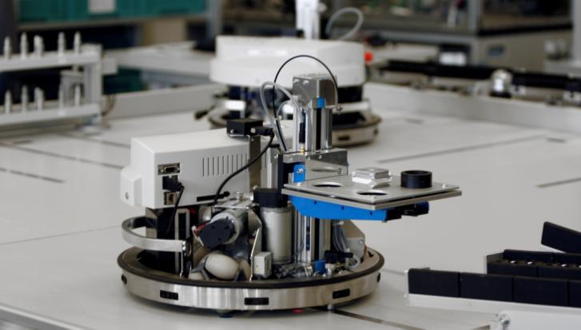
ProLog factory
Logistic training platform
KANBAN, Just in Sequence, Order scheduling ...
the ProLog factory offers an enthusiastic training platform – not only for logistics!

Slide 2
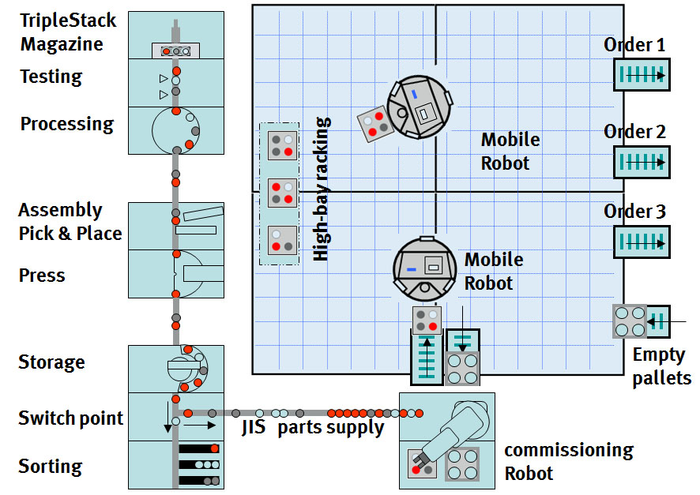
ProLog factory
Production line
Warehouse area
The ProLog factory consists of 3 main areas:
The Production Line, where the products are produced
The Commissioning Station , where the orders are picked
The Warehouse Area, where the orders (pallets) are buffered until delivery
Commissioning station

Slide 3
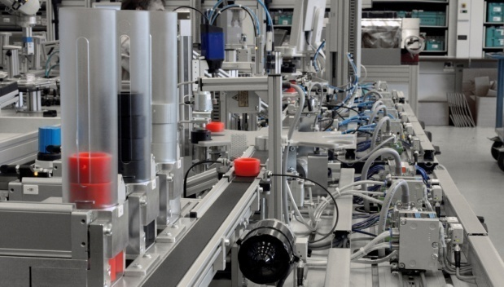
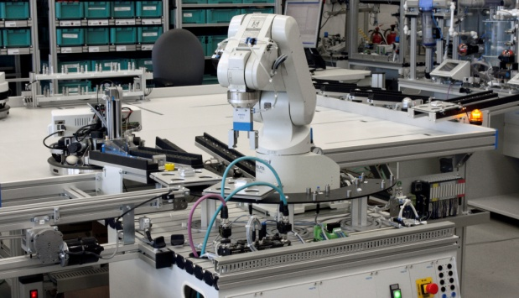
ProLog factory
Warehouse area
The ProLog factory consists of 3 main areas:
The Production Line, where the products are produced
The Commissioning Station , where the orders are picked
The Warehouse Area, where the orders (pallets) are buffered until delivery
Production line
Commissioning station

Slide 4
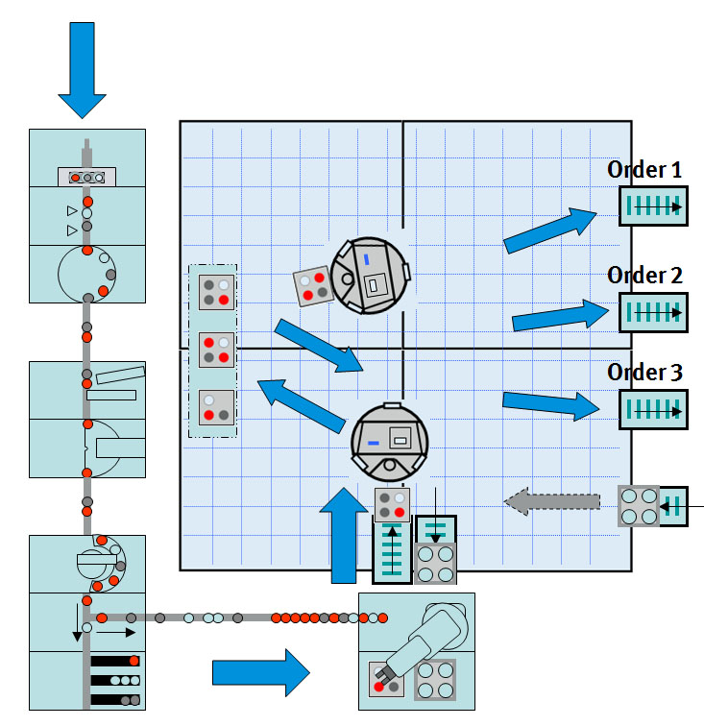
ProLog factory
Material flow:
The processes and the material flow in PRO-LOG Factory is an image of a real production and distributing enterprise.

Slide 5
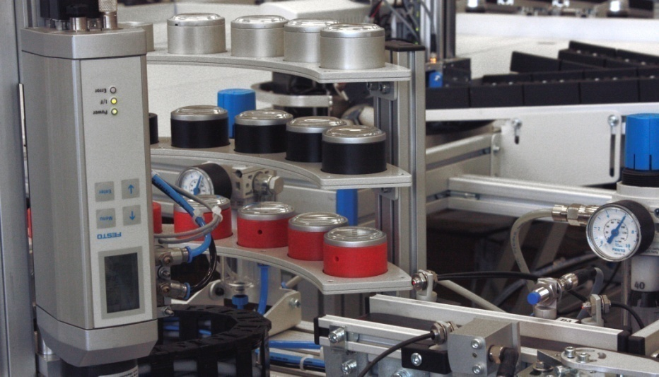
ProLog factory
Material flow:
The processes and the material flow in PRO-LOG Factory is an image of a real production and distributing enterprise.
There are buffers and magazines for the raw materials, and a storage for the single products.

Slide 6
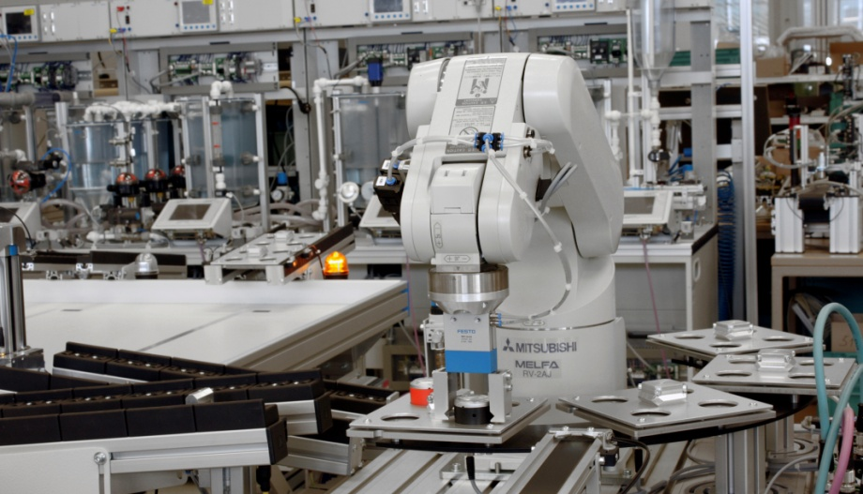
ProLog factory
Material flow:
The processes and the material flow in PRO-LOG Factory is an image of a real production and distributing enterprise.
According to the customer orders, the products are transported JIS (just in sequence) to the commissioning robot.

Slide 7
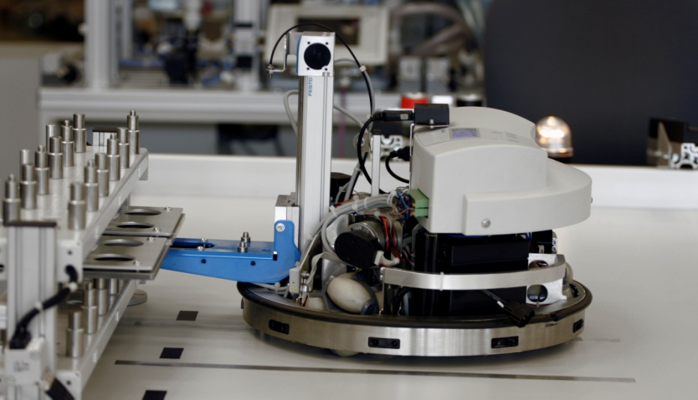
ProLog factory
Material flow:
The processes and the material flow in PRO-LOG Factory is an image of a real production and distributing enterprise.
The pallets are stored in a high bay storage.

Slide 8
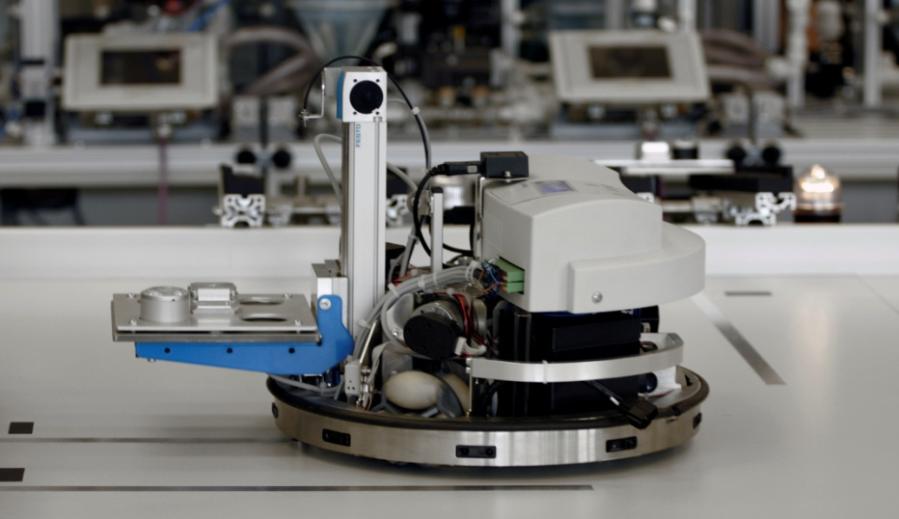
ProLog factory
Material flow:
The processes and the material flow in PRO-LOG Factory is an image of a real production and distributing enterprise.
The mobile robots are equipped with a fork on a telescope arm and work as a fork lift to reach the positions of the racking

Slide 9
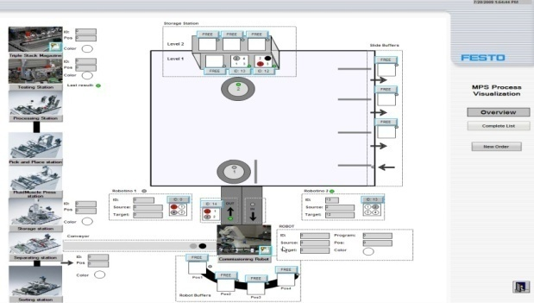
ProLog factory
Mechatronics
Mobile robotics
The Prolog factory offers a wide range of different training topics:
Mechatronics,
Robotics and mobile robotics,
Different Communication technologies
HMI visualisation and process monitoring
HMI and Communication
Robotics

Slide 10
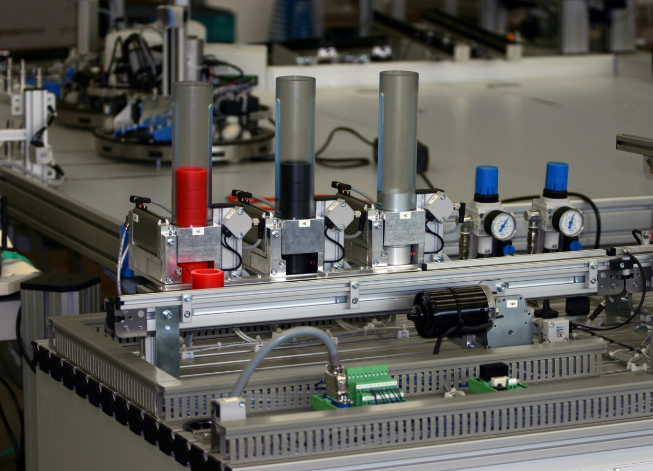
ProLog factory
Distribution station with 3 independent stack magazines
The Prolog factory offers a wide range of different training topics:
The MPS stations in the ProLog factory cover:
PLC training
A wide range of handling components,
Vacuum technolgy,
Sensorics
Drive technolgy

Slide 11
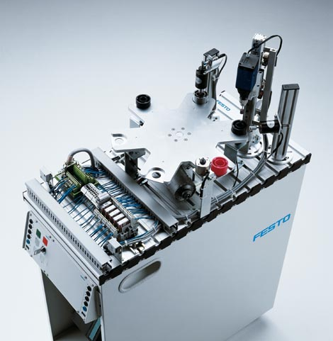
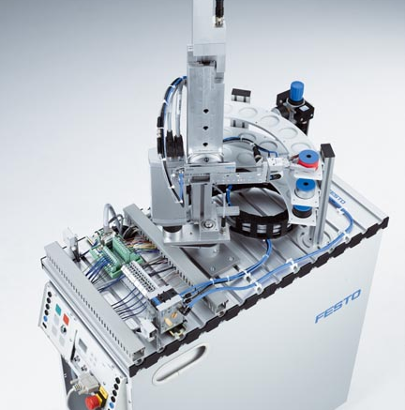
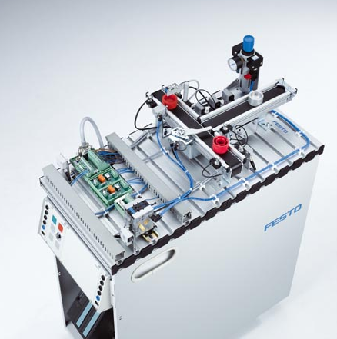
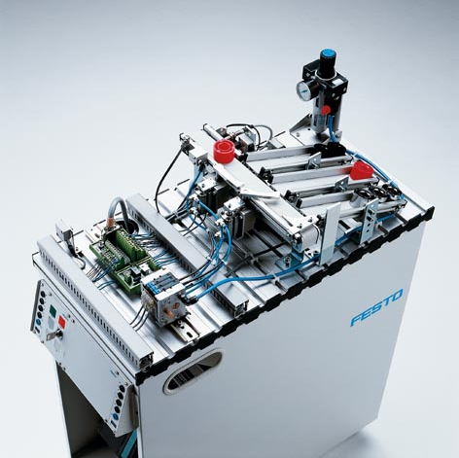
Standard MPS stations:
Processing Pick&Place FluidicMuscle press
ProLog factory
The Prolog factory offers a wide range of different training topics:
The MPS stations in the ProLog factory cover:
PLC training
A wide range of handling components,
Vacuum technolgy,
Sensorics
Drive technolgy
Storing Separating Sorting

Slide 12
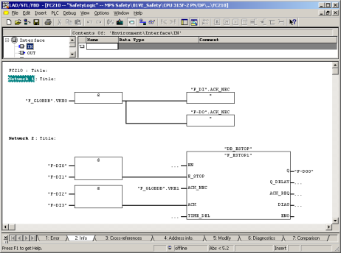
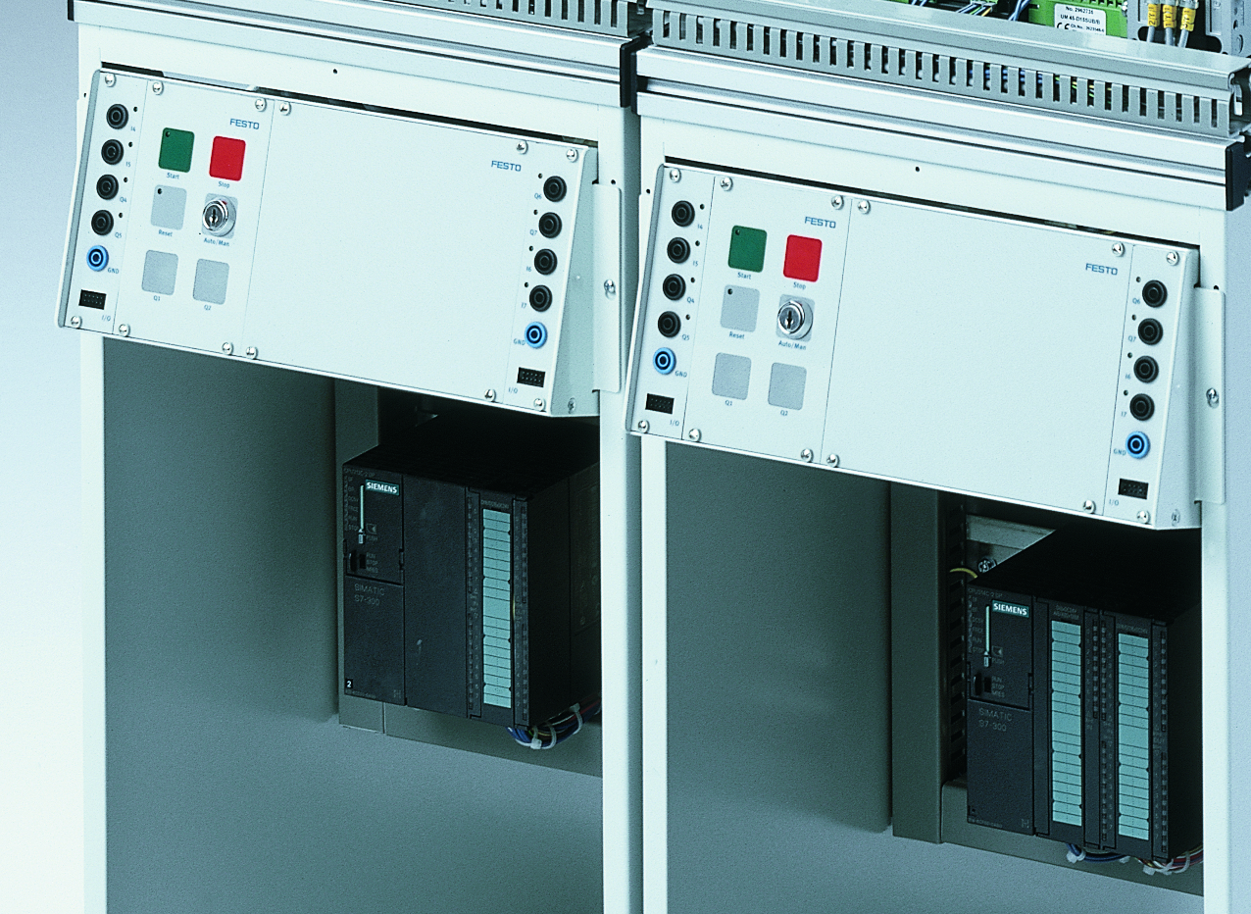
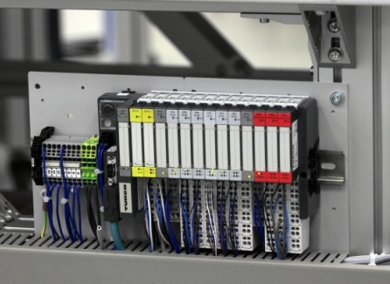
Sample programs and exercises
All stations include tested
programs and sample exercises
Optimised for training
Fully equipped and wired PLC boards
can be mounted or suspended
directly in the trolley. The PLC board
can be simply removed from the
trolley and placed on any table when
working on the PLC board or for
demonstration purposes.
Plug-in and go
The station, the control console
and the PLC boards are equipped
with standardised SysLink interfaces.
No wiring is required – the
boards simply plug in.
ProLog factory
The Prolog factory offers a wide range of different training topics:
The MPS stations in the ProLog factory cover:
PLC training
A wide range of handling components,
Vacuum technolgy,
Sensorics
Drive technolgy

Slide 13
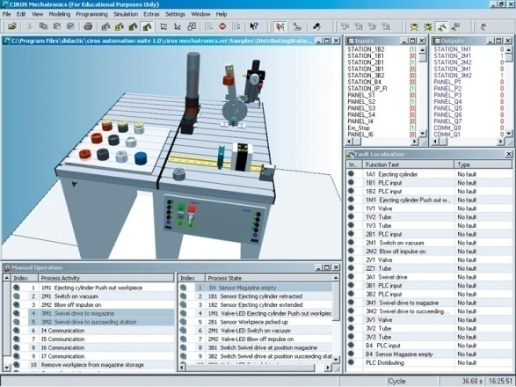
Simulating stations
CIROS® Mechatronics
offers optimum prepa-
ration for a hands-on
lesson.
All the stations can be
tested and programmed
in simulation.
Bugs can even be
built into the model
to permit an optimum,
practical Starting point
for lessons.
ProLog factory
The Prolog factory offers a wide range of different training topics:
The MPS stations in the ProLog factory cover:
PLC training
A wide range of handling components,
Vacuum technolgy,
Sensorics
Drive technolgy

Slide 14
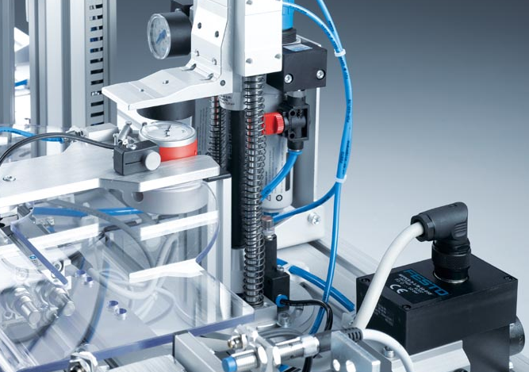
Handling
Linear slides,
Rotating drives
Sorting gates,
Valve terminals,
Analogue proportional
pressure regulator,
Fluidic muscle
… and further more.
In the ProLog factory
all typical automation
components are
integrated.
ProLog factory
The Prolog factory offers a wide range of different training topics:
The MPS stations in the ProLog factory cover:
PLC training
A wide range of handling components,
Vacuum technolgy,
Sensorics
Drive technolgy

Slide 15
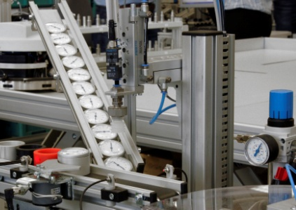
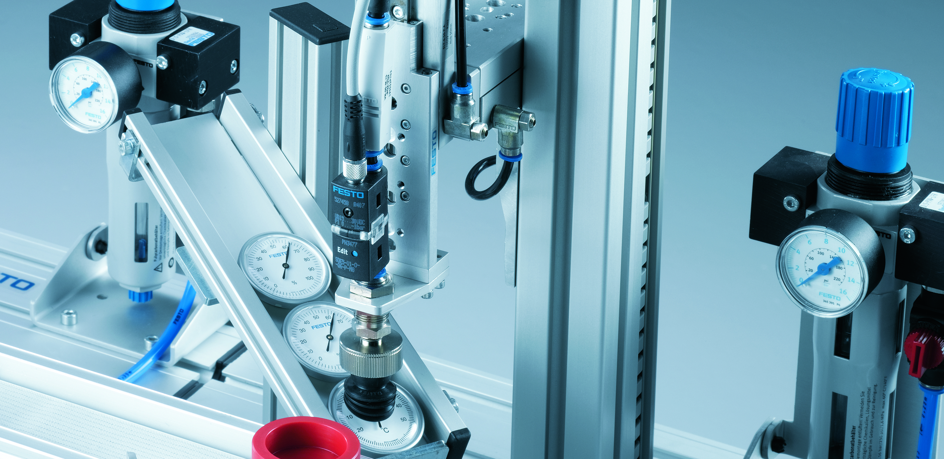
Vacuum technology
Suction gripper,
Vacuum filter,
Vacuum sensor
and vacuum generator.
In the ProLog factory
all typical automation
components are
integrated.
ProLog factory
The Prolog factory offers a wide range of different training topics:
The MPS stations in the ProLog factory cover:
PLC training
A wide range of handling components,
Vacuum technolgy,
Sensorics
Drive technolgy

Slide 16
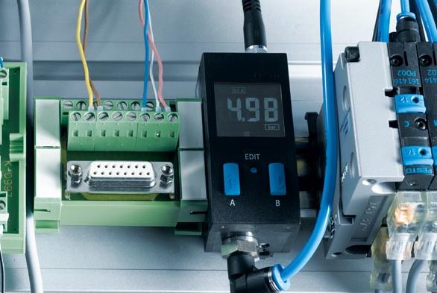
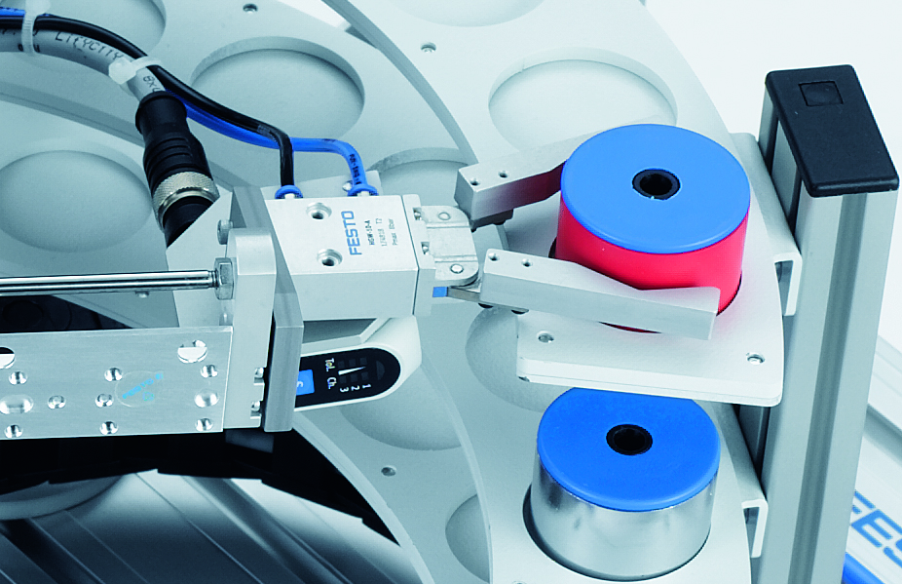
Sensorics
Optical, inductive
and capacitive sensors
Colour sensor,
Laser distance sensors,
Pressure sensor,
Vacuum sensor and
A wide range of sensors
for end position detection.
In the ProLog factory
all typical automation
components are
integrated.
ProLog factory
The Prolog factory offers a wide range of different training topics:
The MPS stations in the ProLog factory cover:
PLC training
A wide range of handling components,
Vacuum technolgy,
Sensorics
Drive technolgy

Slide 17
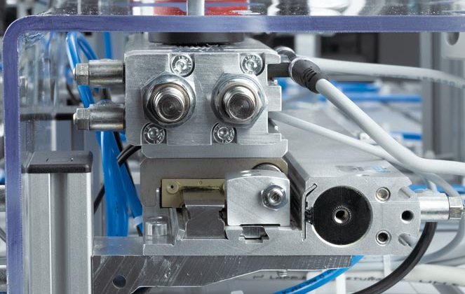
Drive technology
Servo motor MTR-DCI,
Electrical mini slide SLTE with
Integrated encoder,
DC motors for conveyors
and a wide range of different
Pneumatic drives.
In the ProLog factory
all typical automation
components are
integrated.
ProLog factory
The Prolog factory offers a wide range of different training topics:
The MPS stations in the ProLog factory cover:
PLC training
A wide range of handling components,
Vacuum technolgy,
Sensorics
Drive technolgy

Slide 18
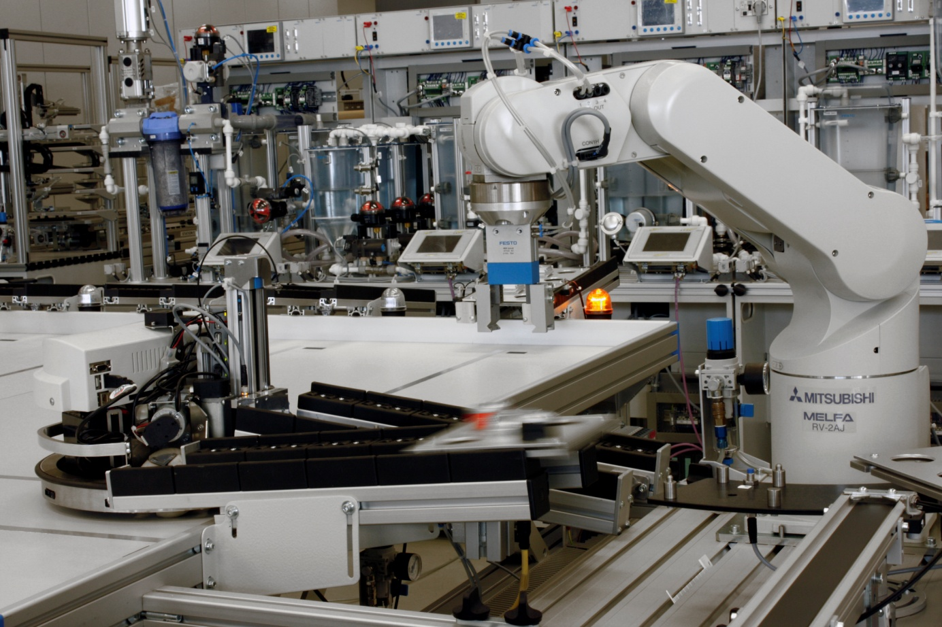
Robotics
ProLog factory
The Prolog factory offers a wide range of different training topics:
Robotics learning environment:
Robot application with Industrial 5 or 6 axis robot
Simulation ‚CIROS‘

Slide 19
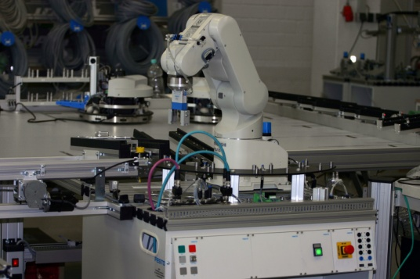
Robot application with 5 or 6
axis
Complete cell with profile frame,
operating panel,
Industrial robot,
Pneumatic gripper,
Application with palletizing,
Integration of automated
Modules,
pallet buffer with sensors,
Roller chains (1 IN, 2 OUT)
In the ProLog factory
all typical automation
components are
integrated.
ProLog factory
The Prolog factory offers a wide range of different training topics:
Robotics learning environment:
Robot application with Industrial 5 or 6 axis robot
Simulation ‚CIROS‘

Slide 20
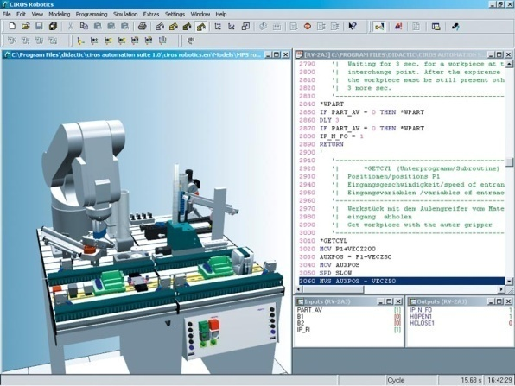
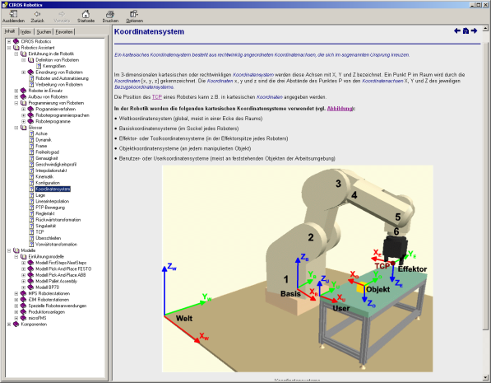
Robot Simulation CIROS
CIROS® Robotics is ideally
suited for learning how to
program and commission
industrial robot systems.
The program offers a large
number of different robot
models.
The integrated training
program on robotics conveys
everything from the basic
principles of handling
technology to the use of
robots in space missions.
ProLog factory
The Prolog factory offers a wide range of different training topics:
Robotics learning environment:
Robot application with Industrial 5 or 6 axis robot
Simulation ‚CIROS‘

Slide 21
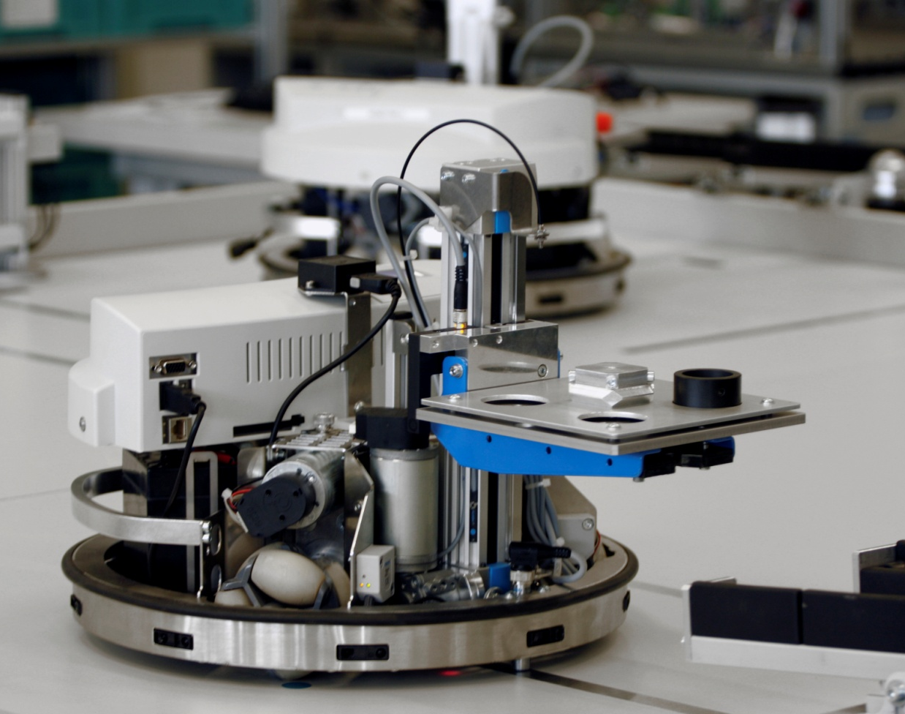
ProLog factory
The Prolog factory offers a wide range of different training topics:
Mobile robotics learning environment:
Mobile robot ‚Robotino‘
Robotino View
Robotino SIM
Special applications

Slide 22
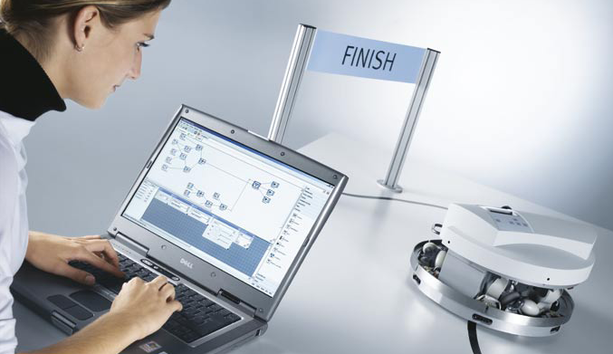
Mobile robot Robotino®
Interactive learning:
The Robotino® is autonomous! Numerous sensors, a camera
and a high-performance controller provide the system with
the necessary „intelligence“. So when it is correctly
programmed, it can handle the tasks assigned to it
autonomously.
ProLog factory
The Prolog factory offers a wide range of different training topics:
Mobile robotics learning environment:
Mobile robot ‚Robotino‘
Robotino View
Robotino SIM
Special applications

Slide 23
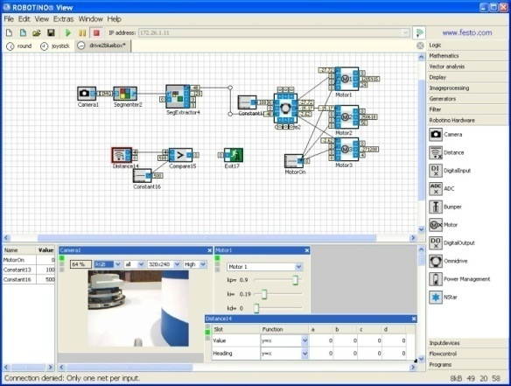
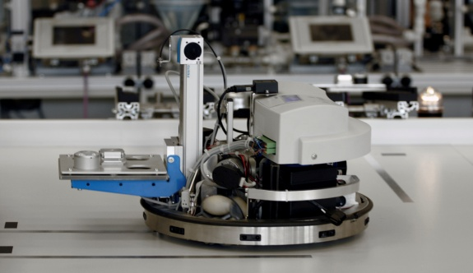
Robotino® View
Robotino® View is the inter-
active, graphical programming
and Learning environment for
Robotino®. It communicates
directly with the robot
system via wireless LAN,
ProLog factory
The Prolog factory offers a wide range of different training topics:
Robotics & Mobile robotics learning environment:
Mobile robot ‚Robotino‘
Robotino View
Robotino SIM
Special applications
Wireless LAN
communication

Slide 24
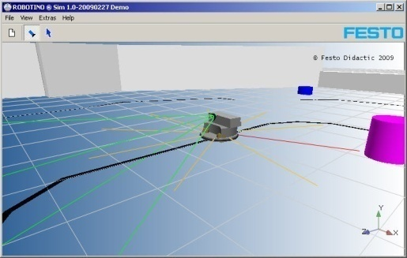
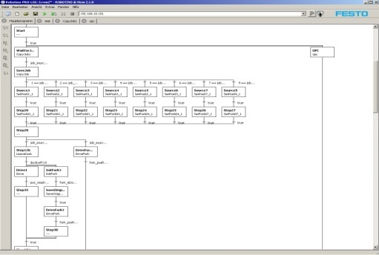
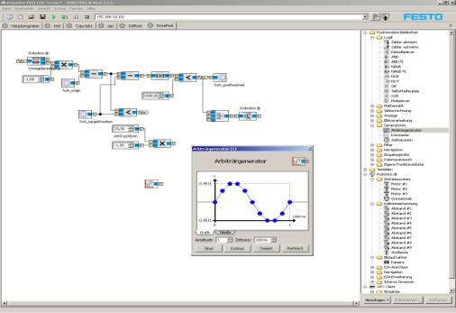
Robotino® SIM
The integrated 3D simulation
Simulates the moving behaviour,
the distance sensors and the
camera in a predefined working
environment. This enables you to
test your first Robotino® View
programs in the simulation
before using them on the real
Robotino®.
ProLog factory
The Prolog factory offers a wide range of different training topics:
Robotics & Mobile robotics learning environment:
Mobile robot ‚Robotino‘
Robotino View
Robotino SIM
Special applications

Slide 25
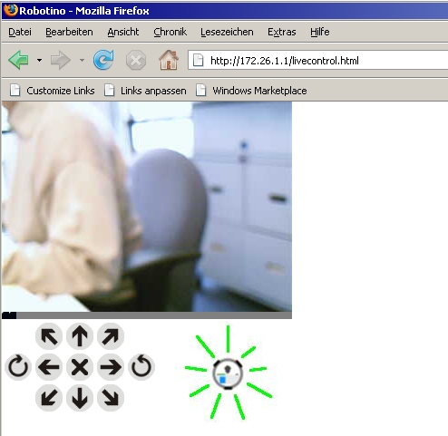
Special applications
The open structure of
Robotino allows a wide
range of different
applications.
ProLog factory
The Prolog factory offers a wide range of different training topics:
Robotics & Mobile robotics learning environment:
Mobile robot ‚Robotino‘
Robotino View
Robotino SIM
Special applications

Slide 26
The PRO-LOG Factory covers all state of the art industrial
communication levels and control technologies.
ProLog factory
The Prolog factory offers a wide range of different training topics:
HMI and communication:
communication levels
control technologies

Slide 27
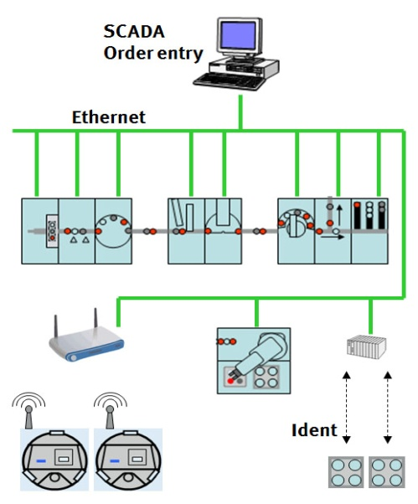
The communication levels are:
Factory level: Order Entry
Plant level: SCADA
Device level: PLC, RC
ProLog factory
The Prolog factory offers a wide range of different training topics:
HMI and communication:
communication levels
control technologies

Slide 28
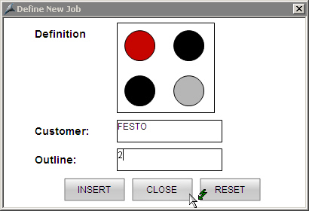
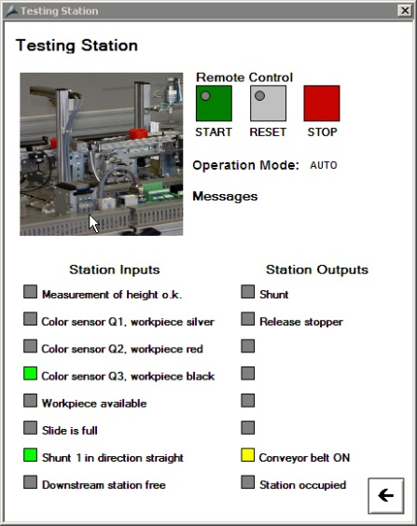
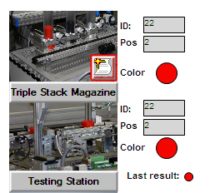
The communication levels are:
Factory level: Order Entry
Plant level: SCADA
Device level: PLC, RC
ProLog factory
The Prolog factory offers a wide range of different training topics:
HMI and communication:
communication levels
control technologies

Slide 29
The communication levels are:
Factory level: Order Entry
Plant level: SCADA
Device level: PLC, RC
ProLog factory
The Prolog factory offers a wide range of different training topics:
HMI and communication:
communication levels
control technologies

Slide 30
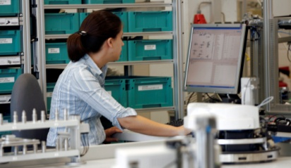
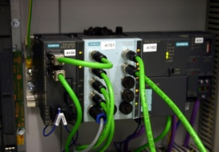
The control technologies are:
Ethernet, RFID and Wireless
ProLog factory
WLAN
The Prolog factory offers a wide range of different training topics:
HMI and communication:
communication levels
control technologies
RFID

Slide 31
ProLog factory
The unique training platform from Festo Didactic
for an enthusiastic training in Logistics, communication technolgy, mechatronics and industrial engineering.

